Slide 1

Analysis of News Impact on Stock Market
By: Harsh Dalwadi & Krutarth Majmundar

Slide 2

Introduction
Project Background: This project originally aimed to explore the real-time impact of news on stock prices using Amazon Kinesis. However, we have since shifted our approach to use Apache Beam and Graphana for data analysis and visualization.
Importance: Analyzing news and stock price data is crucial for understanding how global events influence financial markets, helping investors and analysts make informed decisions.

Slide 3
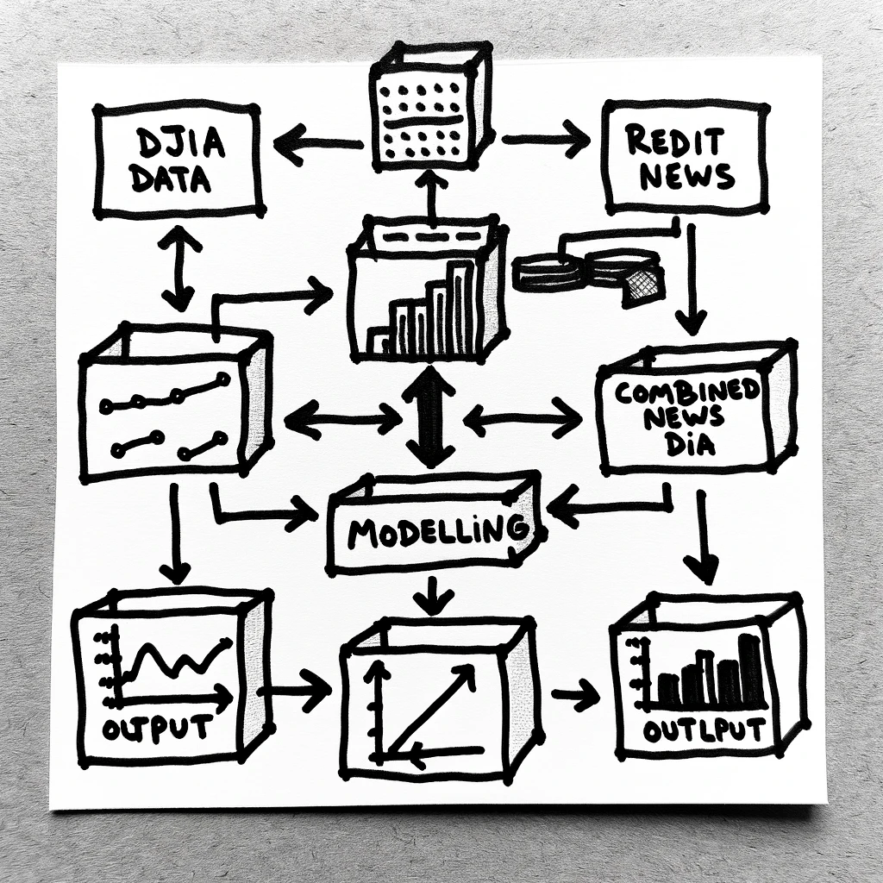
Methodology
Data Sources: Our project uses historical news headlines from Reddit's WorldNews channel and Dow Jones Industrial Average data. While not real-time, these datasets offer valuable insights into past events.
Processing Techniques: We apply Apache Beam for data analysis and transformation, and Graphana for interactive visualization, enabling us to explore historical correlations between news and stock prices.

Slide 4

Thank you

